Slide 1
On Becoming a Leader in Risk Management
Fundamentals of RM
RM System and Process
Leadership in RM
Incident Investigation
RM Tools & Challenges
RM in Industry
People & Org.
Application and Perspectives
ENGG 404 - Lecture
Chapter 5.1
Tools for Risk Management
1
Notes:
ENGG404 Lecture 00 - Day 1
1
1

Slide 2

Learning Outcomes:
Recognize the tools for leadership in risk management, and explain the overall purpose of these tools
Explain how to resolve risk concerns by applying a risk reduction hierarchy (order of effectiveness)
Interpret, critique, and create various risk management tools:
Apply all of these tools as a rudimentary skill of leadership to observe, interact, commend or intervene / coach employees in the work-place.
Chapter 5.1: Tools for Risk Management
2

Slide 3
Hazard, Consequence, and Risk:
Recall:
Hazard: A potential source of serious harm to people, environment, assets or production.
Consequence: The harm imparted on people, environment, assets or production, when the hazard is uncontrolled
Risk – “something bad could happen”:
The possibility of loss exposures (PEAP) created by a hazard.
Risk is a function of the likelihood of an unwanted incident and the consequence or the impact on PEAP.
Several methodologies are widely practiced.
Chapter 5.1: Tools for Risk Management
3
Notes:
3

Slide 4
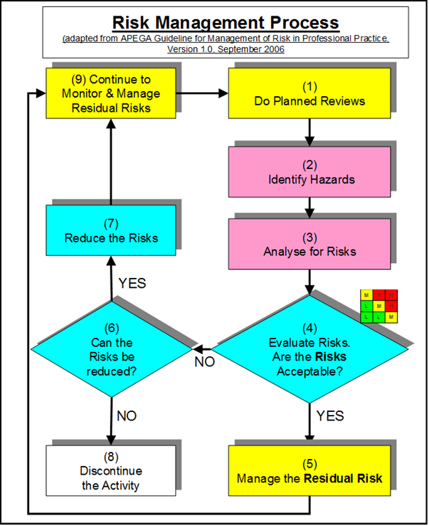
Risk Management Work Process
Recall the RM work process:
Risk is determined before / without control measures, but can also be determined with control measures.
Various tools can be used to analyze and reduce risk to an acceptable level
Chapter 5.1: Tools for Risk Management
4
Notes:
4

Slide 5

Risk Management Tools:
Common RM Tools used in Industry
Have you used any other tools in your work terms? Hands up
Bowties, HAZOPs, What If Analysis, etc…..
5
Chapter 5.1: Tools for Risk Management

Slide 6
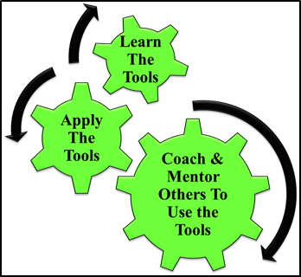
Leadership in Risk Management:
A leader uses these tools to positively influence safety culture in two ways:
Application:
Recall that the purpose of these tools is to manage risks to acceptable levels and prevent incidents.
Coaching & Mentoring:
Powerful management tool to positively influence safety culture,
Trains managers to be effective as leaders in risk management,
Interactions
Raises the visibility of the manager:
“walk the talk”
“lead by example”
Thus, the leader demonstrates management commitment.
Chapter 5.1: Tools for Risk Management
6
Notes:
6

Slide 7
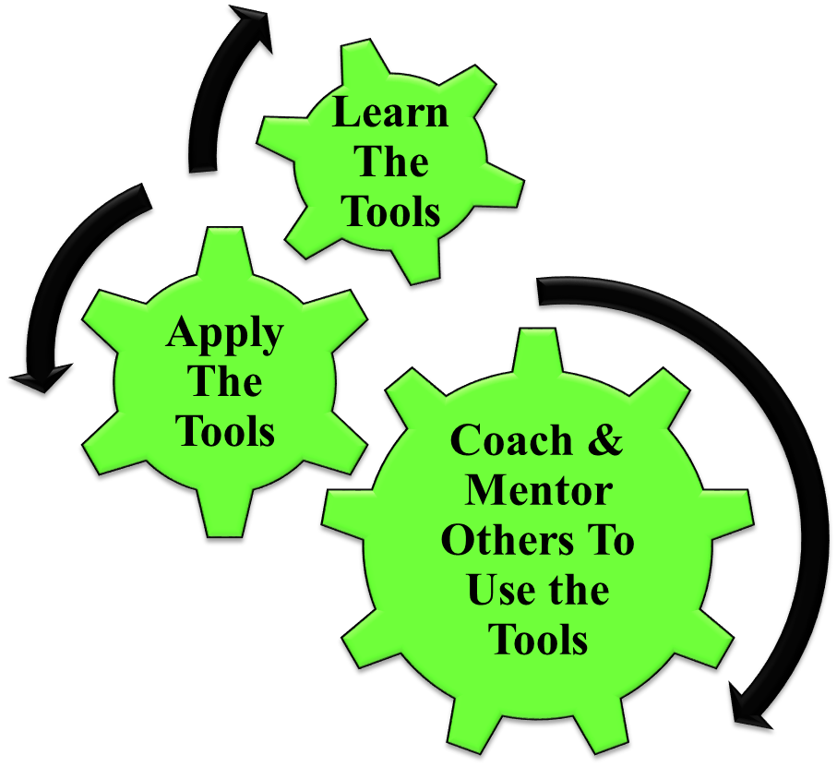
Leadership in Risk Management: How Does This Apply To You as Engineers?
Chapter 5.1: Tools for Risk Management

Slide 8
Summary:
Any risk assessment methodology answers these questions:
What are you doing? (Activity)
What could go wrong (Hazard)?
How bad could it be (Consequence)?
How likely is it to happen (Likelihood)?
What can I do about it? (Controls – Admin or Engr)
How does the control change the L and C?
There are a number of tools that can be used and have the same basic approach.
A leader uses these tools to positively influence safety culture:
Chapter 5.1: Tools for Risk Management
8

Slide 9
On Becoming a Leader in Risk Management
Fundamentals of RM
RM System and Process
Leadership in RM
Incident Investigation
RM Tools & Challenges
RM in Industry
People & Org.
Application and Perspectives
ENGG 404
Chapter 5.2
The Fundamental Approach to Control All Risks (Order of Effectiveness)
9
Notes:
ENGG404 Lecture 00 - Day 1
9
9

Slide 10
Introduction:
You want to implement the most effective risk reduction solutions (engineering controls & administrative controls)
How do you identify, evaluate, and select the most effective risk reduction solutions?
NOT necessarily an order of priority!
What tool did you recently learn that helps us to prioritize recommendations?
Chapter 5.2: Fundamental Approach to Control All Risks
10
Notes:
10

Slide 11
Risk Reduction Hierarchy & Order of Effectiveness:
AB OH&S Code Part 2, Risk Reduction Hierarchy:
Eliminate
Apply Engineering Controls
Apply Administrative Controls and Work Practices
Use PPE
Use combinations of above.
Chapter 5.2: Fundamental Approach to Control All Risks
11
Notes:
11

Slide 12
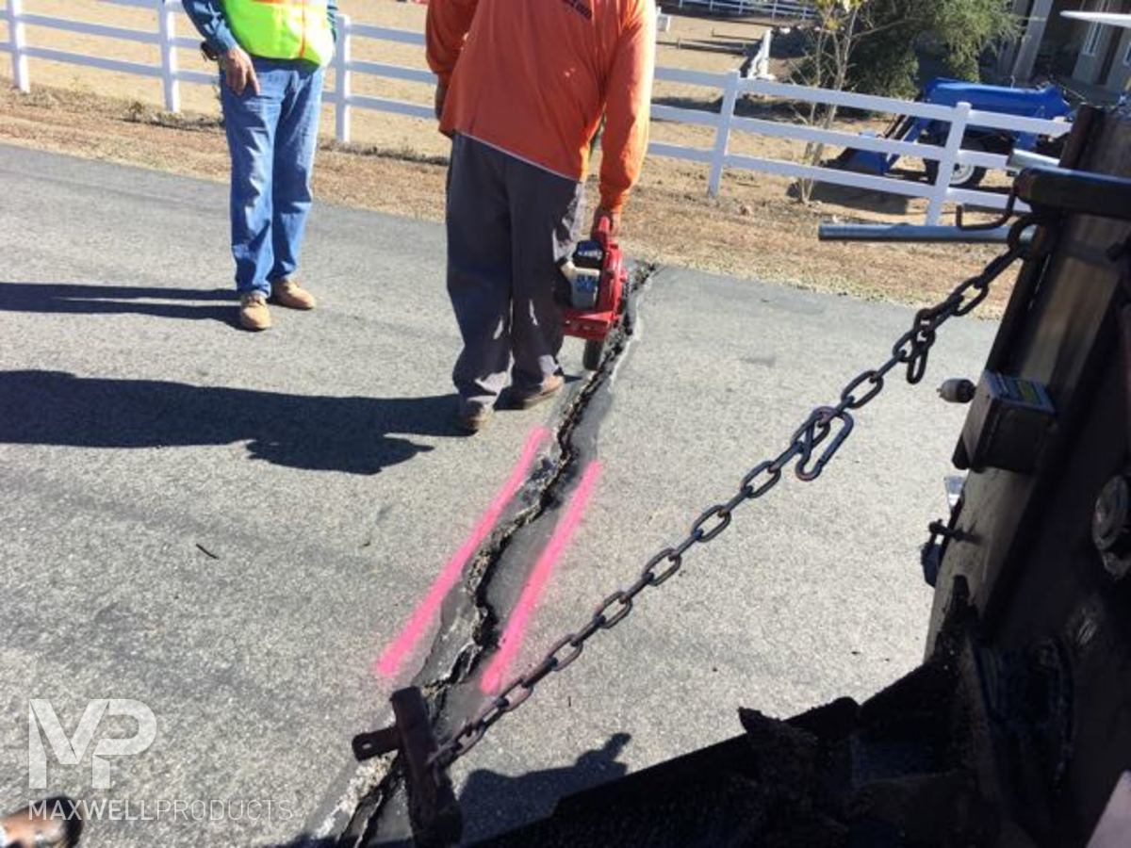
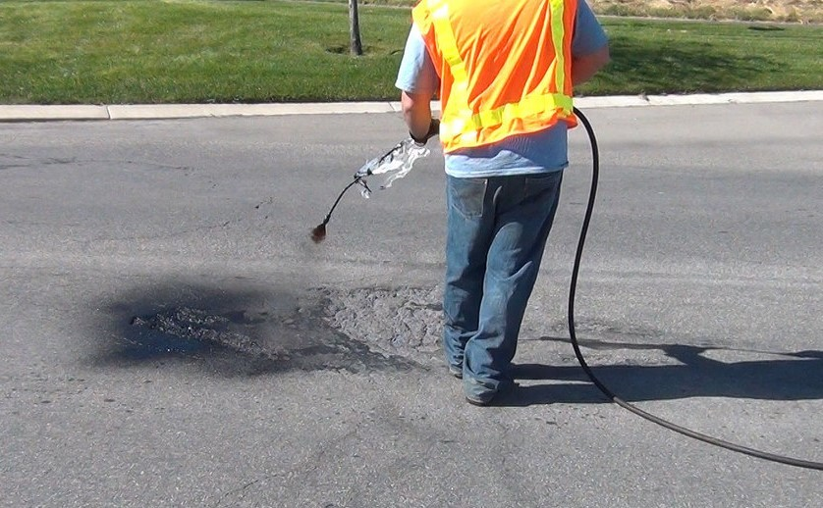
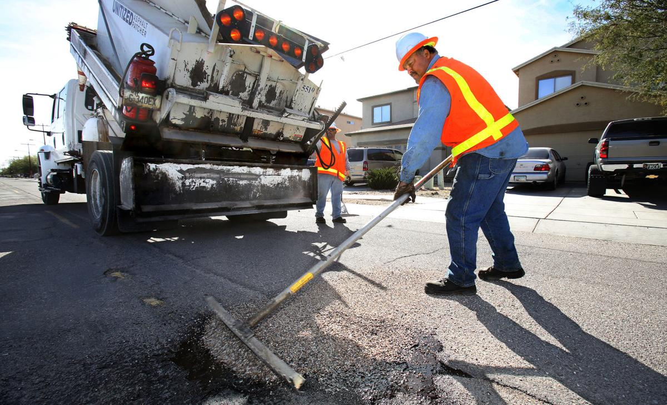
Risk Reduction Hierarchy & Order of Effectiveness:
Consider this job (activity) and its hazards:
Job: typical spray-patch crew: crack is gouged, sprayed with hot tar-oil, filled and tamped with pea gravel.
Hazards to address: exposure to traffic, crushed by moving dump truck, repetitive shoveling / spraying motions, contact with hot tar.
How can you eliminate some or all of these hazards?
Chapter 5.2: Fundamental Approach to Control All Risks
12
Notes:
12

Slide 13
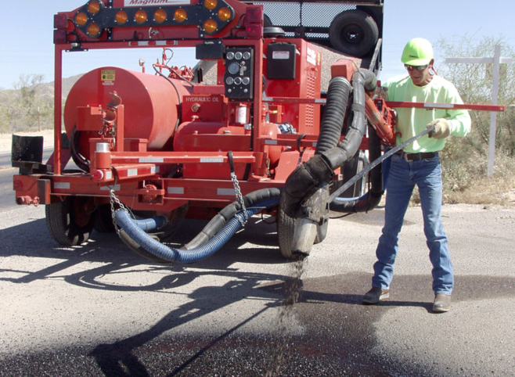
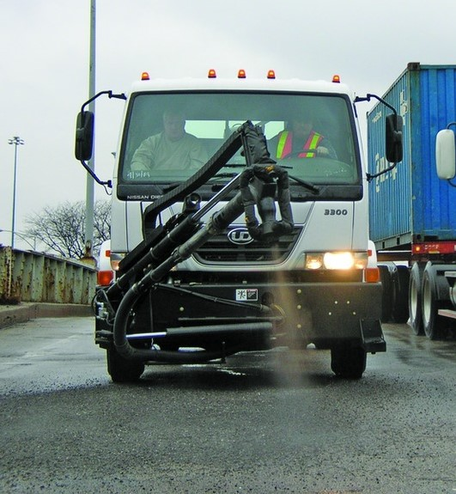
Change the Design of the Equipment (PTD)
Eliminates: crushed by moving dump truck, repetitive shoveling motion,
contact with hot tar.
Eliminates: crushed by moving dump truck, all repetitive motions, contact with hot tar AND exposure to traffic.
Chapter 5.2: Fundamental Approach to Control All Risks
13
Notes:
13

Slide 14
Risk Reduction Hierarchy & Order of Effectiveness:
But it is usually “prioritized” because it’s easy!
14
Notes:
14

Slide 15
15
Notes:
15

Slide 16
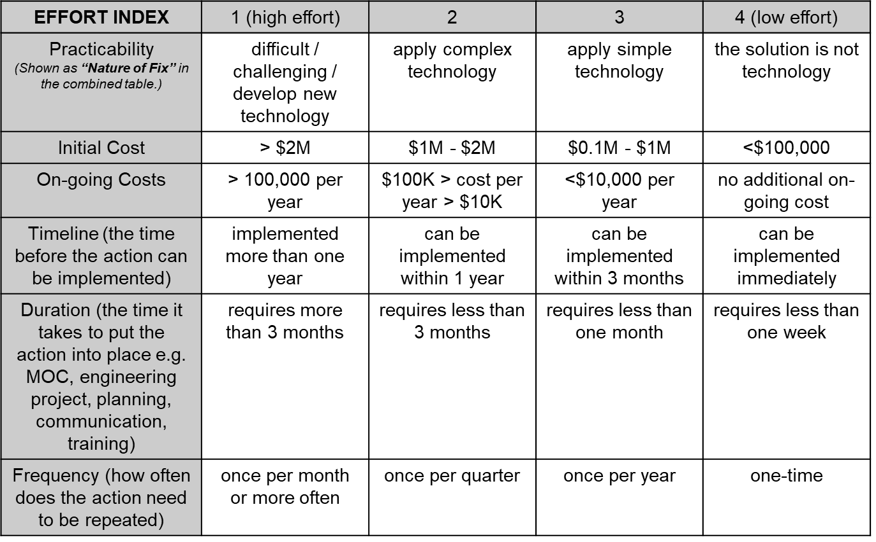
Difference Between Order of Effectiveness & Order of Priority
Key difference!
… and it is not necessarily “safety at all costs”.
This tool yields an order of effectiveness.
This tool yields an order of priority.
Chapter 5.2: Fundamental Approach to Control All Risks
16
Notes:
16
I.e. PPE – you prioritize it because it’s easy and cheap, but it is not the most effective risk reduction solution!

